Slide 1
Rare Disease
Case Studies

Slide 2
Case study:
End-to-End Evidence Generation in Dilated Cardiomyopathy (DCM)
Enabling progression from feasibility assessment to natural history study to external control arm (ECA) within a single integrated platform
Pulse implemented a staged, platform-enabled approach to accelerate evidence generation that scales with evolving sponsor requirements
Phase II: Platform Configuration
Configured DCM, specific data structure (clinical, genomics, PROs)
Designed to support protocol and informed consent development , regulatory submissions and site onboarding
Phase III: Natural History Study Execution & ECA development
Launching across 8 global sites with real-time analytics dashboards
Collecting longitudinal, standardized data over 18 months
Developing a regulatory-ready External Control-Arm dataset
Phase I: Discovery & Feasibility Analysis:
Multi-stakeholder interviews and site landscape review
Identified relevant endpoints, data availability and regulatory/scientific requirements
Assessed potential for decentralized patient recruitment
Project Context
Rare and heterogeneous disease (DCM) requires longitudinal real-world data to capture variability in disease progression, patient outcomes, and clinical treatment patterns
In rare disease, conventional randomized trials alone are insufficient to support study design including definition of clinically meaningful endpoints in support of regulatory submissions
Need for a scalable platform that supports feasibility analysis, natural history data collection, external control arm development, and long-term safety follow-up.
Importance of regulatory alignment, patient inclusion, and site engagement across global geographies

Slide 3

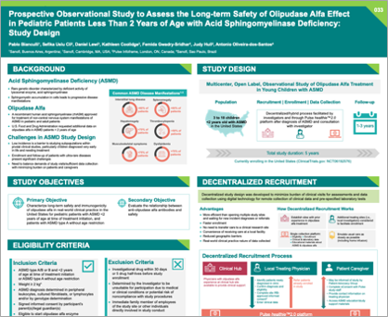
Case study: ​
Decentralized recruitment methodology
Prospective Observational Study to Assess the Long-term Safety of Olipudase Alfa in Pediatric Patients Less Than 2 Years of Age with ASMD: Study Design
Pablo Bianculli, Sefika Uslu Cil, Daniel Lewi, Kathleen Coolidge, Femida Gwadry-Sridhar, Judy Hull, Antonio Oliveira-dos-Santos
An agile an efficient, decentralized study design by Pulse and accepted by FDA for an ultra rare disease
The project was to support a study to assess long-term safety and immune response of a drug in pediatric patients treated before age 2 and in patients with no age restriction.
Evaluate the relationship between treatment-related antibodies and safety outcomes Data Collection Timing: At every infusion (every 2 weeks) during dose escalation, every 3 months up to 24 months, and at 36 months..
A decentralized approach was implemented to reduce the burden of clinical visits, using digital technology for remote clinical data and lab test collection.
Decentralized design provided a variety of advantages including a more efficient approach than opening multiple sites, faster enrollment, no care transfer needed, local care convenience, reduced geographic barriers, and real-world data collection.
Click here to read the poster

Slide 4


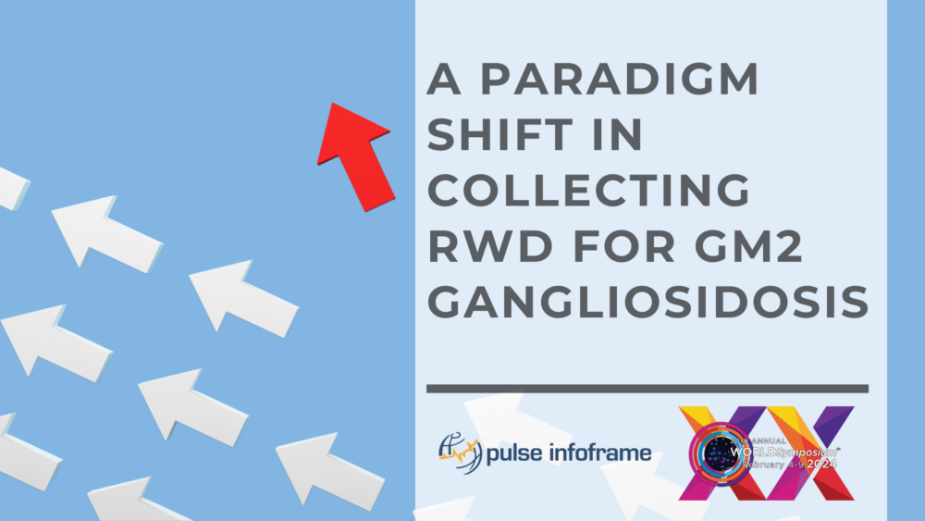
Case study:
Feasibility process for GM2 gangliosidosis
Pulse presented its feasibility assessment approach at the WORLDSymposium 2024 in relation to a project for GM2 gangliosidosis
Real-world data (RWD) collection for GM2 gangliosidosis has long been fragmented and incomplete.
By engaging clinicians, researchers, and advocates, Pulse developed a unified framework that supports transparent, high-quality data collection across drug development.
This model not only improves research for GM2 but also offers a blueprint for advancing rare disease understanding more broadly.
Pulse Infoframe led a shift toward a more collaborative and standardized approach, aligning with FDA guidance and addressing key gaps such as missing clinical, genomic, and patient-reported data.
Click here to read the poster

Slide 5
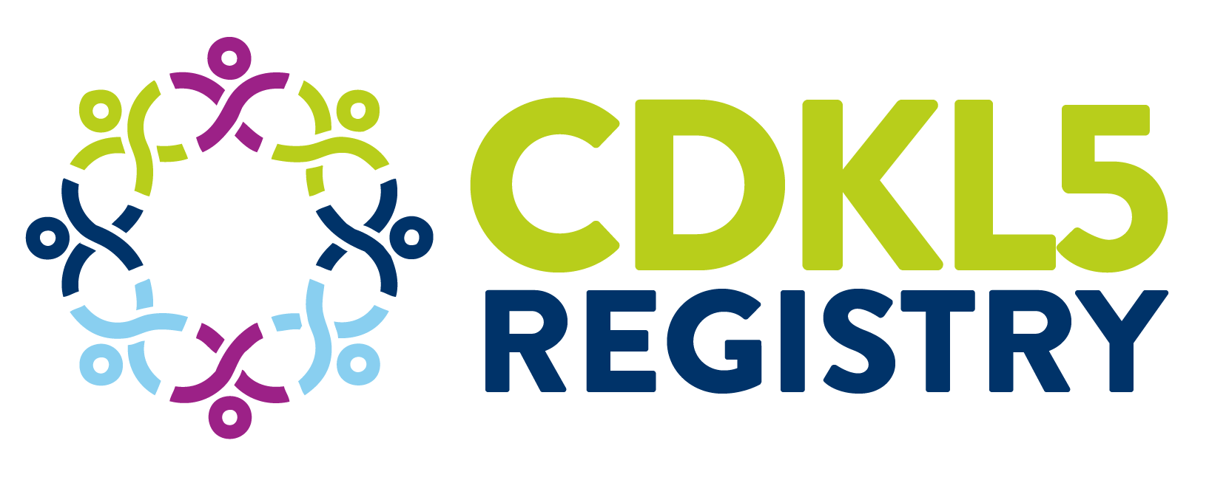
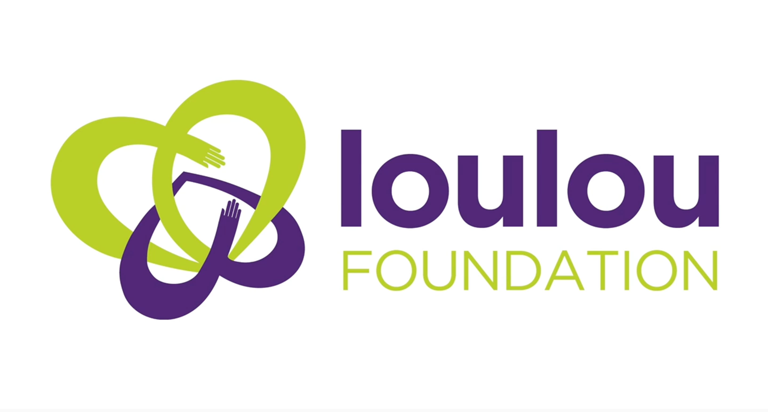

CDKL5 Global Registry
Key statistics
2 PARTNERS
LAUNCH
The CDLK5 Registry was created in collaboration with the LouLou Foundation and Orphan Disease Center (UPenn)
The CDLK5 Registry was launched in 2018 and was in development for 2 years. Now, 7 pharma have collaborated on an endpoint-enabling study with data linked to the CDKL5 registry through our GUID service.
PUBLICATIONS
Data from the CDLK5 Registry has been used in publications to increase the understanding of the disease
PATIENTS ENROLLED
Since its launch, the CDLK5 registry has enrolled over 170 patients and the number of anticipated patients is ~300
Global Access
The CDLK5 Registry has enrolled patients around the world, with the largest dataset collected on the CDLK5 community coming from the US and data shared with Australian researchers through our GUID.

Slide 6
Case study:
GUID-Enabled Data Linkage
Enabling multi-sponsor collaboration through the CDKL5 Registry to link patient data across independent trials and real-world registries without compromising privacy
Pulse implemented a Global Unique Identifier (GUID) system to assign each patient a consistent, anonymized ID across data sources.
GUID creation enabled secure data linkage without exposing personally identifiable information (PII).
Developed a privacy-preserving workflow that allows clinical sites to generate GUIDs independently which also allowed patients participating in multiple studies to be tracked and linked within the registry
Enabled a multi-sponsor registry infrastructure with clean, linkable patient data across studies which enhanced data quality and analytic depth by capturing full patient journeys across research contexts
Supported regulatory-grade evidence generation through consistent and traceable patient records which demonstrated Pulse’s ability to implement privacy-first, interoperable data systems to support real-world research in rare diseases
Project Context
Multi-sponsor registry initiative supporting multiple studies in a rare disease population
Need to link patient data across independent trials and real-world registries without compromising privacy
Key challenges: duplicate enrollment, inconsistent patient identifiers, and fragmented data sources
Registry required a secure, standardized solution to harmonize data while complying with global data protection laws
Ensuring data integrity and longitudinal tracking across studies was essential for regulatory-grade evidence

Slide 7
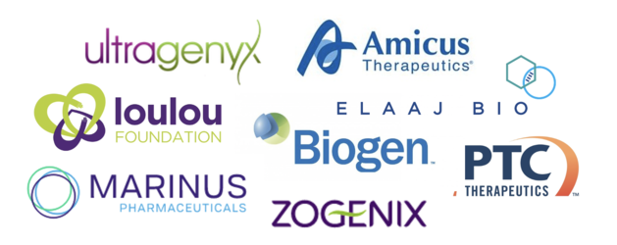
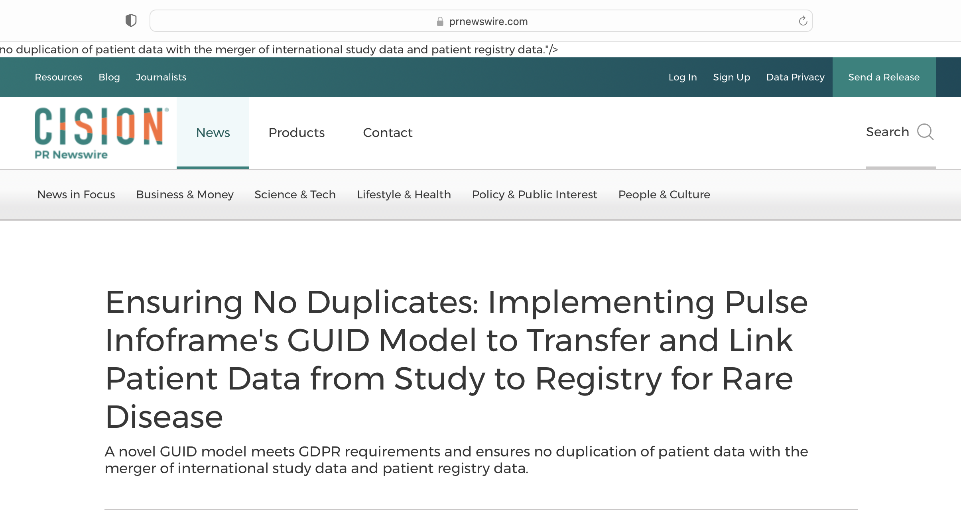
Timeline
Collaboration formed with the LouLou Foundation and Orphan Disease Center (UPenn)
Pre-competitive pharma consortium established to initiate an endpoint-enabling study: CANDID
Registry infrastructure and GUID leveraged to support additional observational studies
2016
2021
2024-
2018
2022
The CDLK5 Registry is launched, powered by Pulse’s platform
Pulse GUID implemented to link CDKL5 Registry and CANDID Study data

Slide 8
CDKL5 Global Registry
Goals, Impact, and Vision
WHAT?
HOW?
RESULTS
A significant gap in the assessment of patient treatment and outcomes because of the lack of systematically captured, reported or analyzed Natural History of Disease.
Physicians lacked insights on:
Survivorship
Quality of life (patient and caregiver)
Lifetime cost of treatment
Social impact of treatment
Disease progression
The CDKL5 Registry collects information from family/caregivers that links to clinical data.
Families are fully consented to learn about opportunities for CDKL5 clinical studies.
Pulse Infoframe provides a secure, data privacy-compliant, centralized evidence generation platform which meets regulatory requirements for clinical data.
Capturing Natural History of Disease data has led to a deeper understanding of:
Implications and impact of genotyping
Quality of life
Impact of reduced time-to-diagnosis
Guidance for symptom management
Patient and caregiver preferences
Implications for large patient cohorts and population health
Incredible value for industry, physicians, payers, and most importantly patients has been unlocked, including::
Greater number of companies being involved in drug development
Endpoint-enabling study
An MOU was established by Pulse to link data between the CDKL5 ODC registry and the IFCR funded Australian work
What’s next ? Additional studies and forming a central repository for CDKL5 data
WHY?

Slide 9
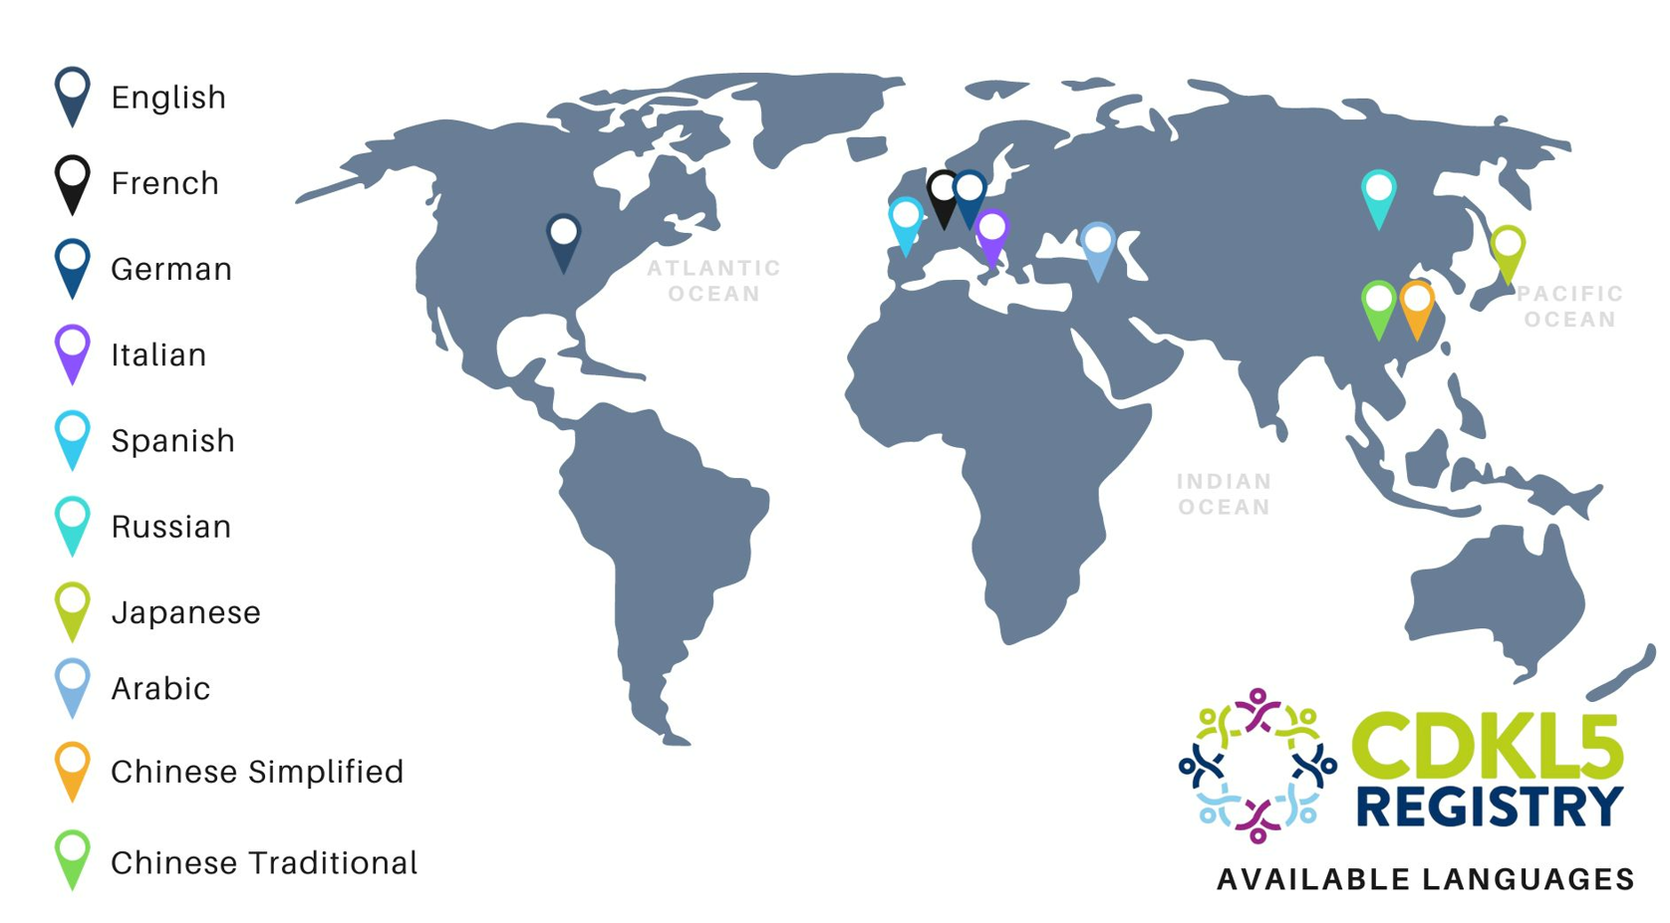
Global Collaboration and Voice

Slide 10
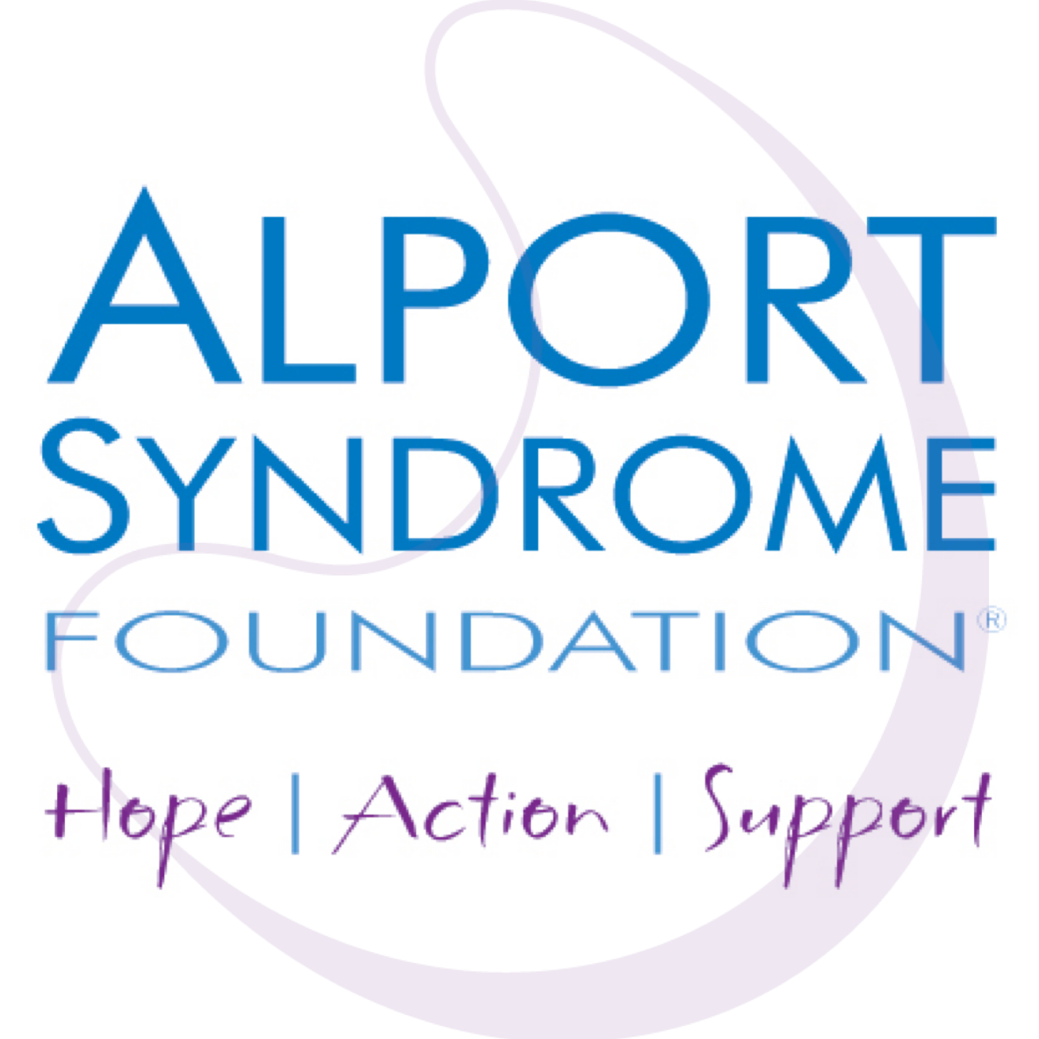
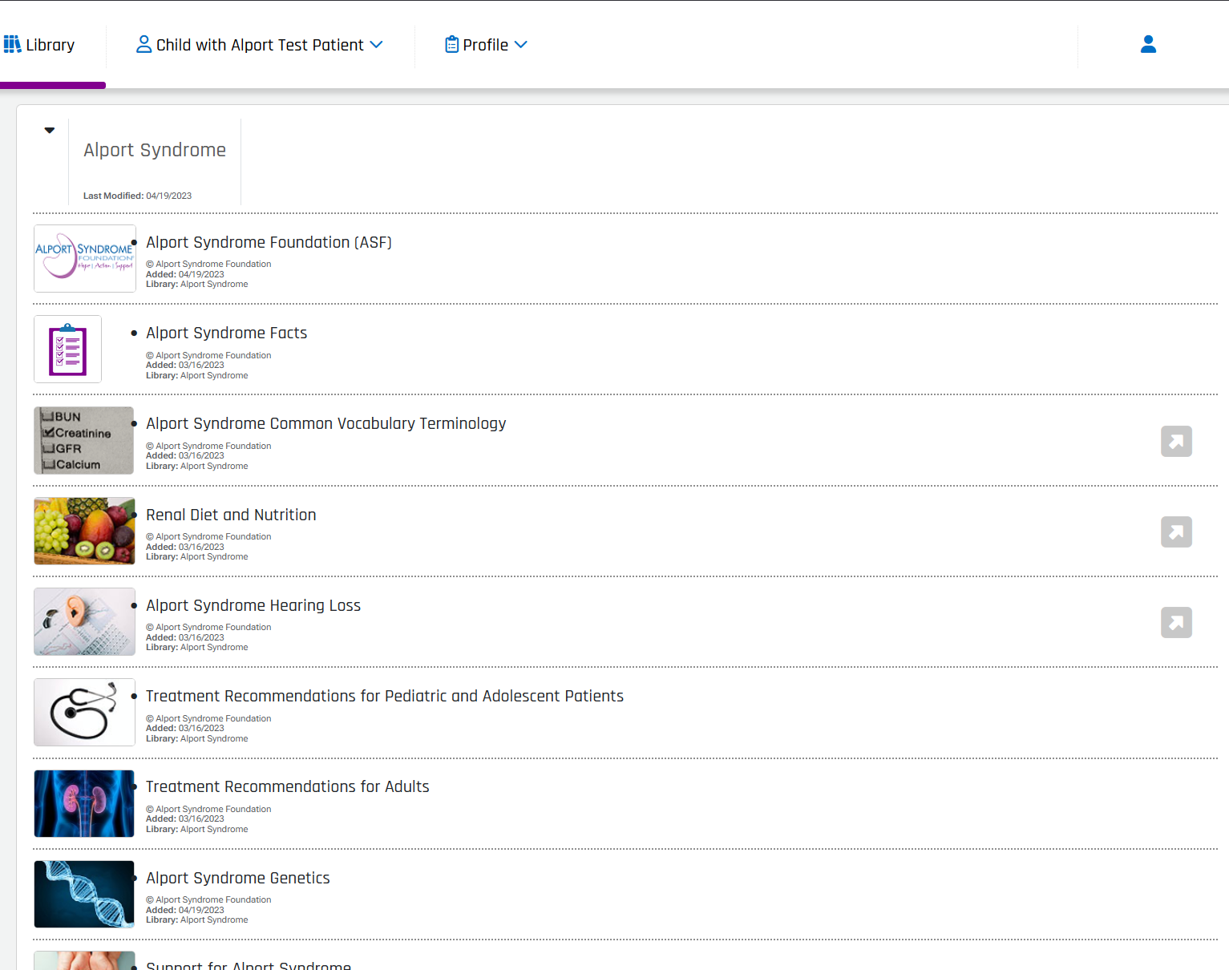
Case study:
Patient engagement
Co-designed with direct feedback through ASF's in-person and virtual patient meetings, surveys, and private online support group played a vital role in identifying data elements.
Launched in August 2023, this IRB-approved, decentralized, ambispective, longitudinal natural history study has over 450 fully consented adult and minor participants
Collaborative approach with patient engagement group played a vital role in identifying data elements that position the registry at the forefront of patient-centered drug development in Alport syndrome
The platform offers interactivity and ease of use for participants, ongoing record collection every six months to monitor disease progression/symptoms/medication changes, and a library of educational resources for patients.
The registry has been designed to capture data to provide insight into the unmet need within a rapidly evolving treatment landscape: genetics, treatment history, hearing loss included.

Slide 11

CATNAP Narcolepsy Registry
GROWTH
Key statistics
GUID leveraged to support additional observational studies, including an endpoint-enabling study launched in 2021 with a pre-competitive pharma consortium.
2 PARTNERS
Children, Adolescents, and Their providers: the Narcolepsy Assessment Partnership (CATNAP™) is a retrospective and prospective longitudinal, multicenter web-based pediatric narcolepsy registry
PUBLICATIONS
Data from the CDLK5 Registry has been used in publications to increase the understanding of the disease.
PATIENTS ENROLLED
Since its launch, the CDLK5 registry has enrolled over 170 patients and the number of anticipated patients is ~300.
Global Access
The CDLK5 Registry has enrolled patients around the world, with the largest dataset collected on the CDLK5 community coming from the US and data shared with Australian researchers through our GUID.

Slide 12
Case study:
A Patient-Centered Approach to Primary Biliary Cholangitis (PBC) Research
Challenge
Solution
Outcome
Rare autoimmune liver disease with severely impactful pruritus
Small, dispersed patient population with cultural, language, and digital literacy barriers
Difficulty linking symptom burden (pruritus, sleep disruption) to clinical and patient-reported outcomes
Feasibility-driven, patient-first hybrid study design
Multilingual, inclusive platform for decentralized participation
Stakeholder collaboration and patient empowerment tools
Integrated clinical and patient-reported data capture
Multilingual platform ready for observational data collection
Clinical site activation in US and Germany
Tools enhancing patient retention and experience
Scalable model for future rare disease research registries
Pulse Infoframe’s approach bridges stakeholder input, platform flexibility, and patient empowerment to ensure compliance, technical readiness, and a patient-centric model grounded in real-world patient voice.

Slide 13
Thank You!
TM

